Slide 1
Working with file

Slide 2
Sequential input and output operations
put() and get() functions are used to write and read a single character into a file.
int main()
{
char string[80];
cin>>string;
Int len=strlen(string);
Fstream file;
File.open(“TEXT”, ios::in|ios::out);
For(int i=0;i<len;i++)
File.put(string[i]);
File.seekg(0);
Char ch;
While(file)
{
File.get(ch);
Cout<<ch;
}
Return 0;
}

Slide 3
Write and read functions
Write and read function are used to handle the data in the binary form.
Infile.read((char*)&V,sizeof(V));
Outfile.write((char*)&V,sizeof(V));

Slide 4
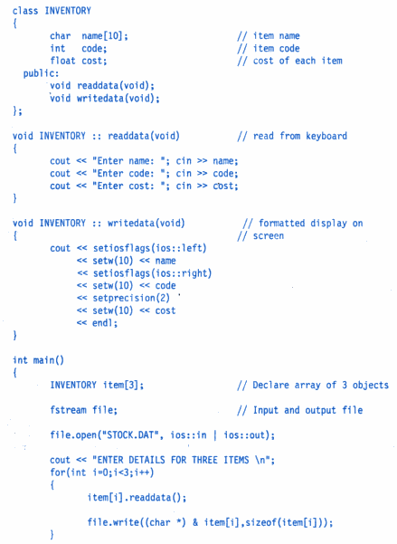
Reading and Writing a class object

Slide 5
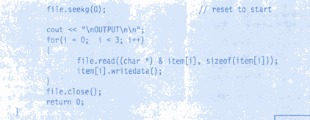

Slide 6
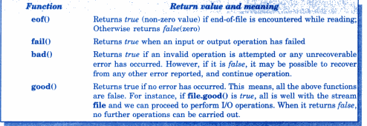
Error Handling during a file operation

